Slide 1
Final Session (#11)!!!
December 14, 2020
Notes:
Names: Hannah, Megan, Zuha, Ana + Paula, Angel, Sasha, Nina

Slide 2
Today’s Agenda
Log On to Arduino web editor
Women-in-Tech Spotlight
SUPER Review of Fall Club
Kit contents
Coding Concepts
Circuit Concepts
Resources
Kahoot!
Lesson & Activity
List of Accomplishments
Next Semester’s Club
Superlatives
Stand ups – anyone who wants to!

Slide 3
Women in Tech Spotlight

Slide 4
Fall SUPER Review

Slide 5
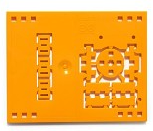
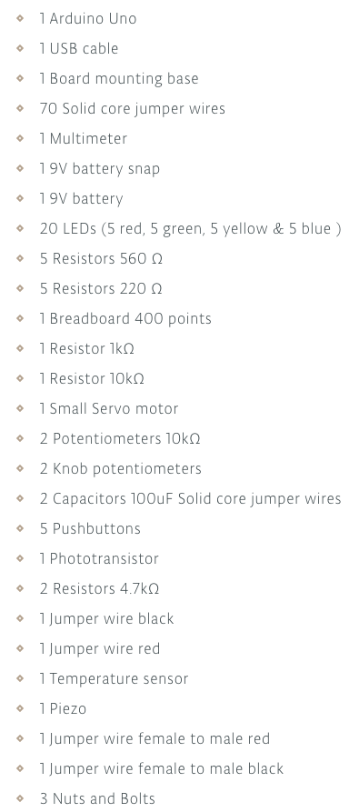
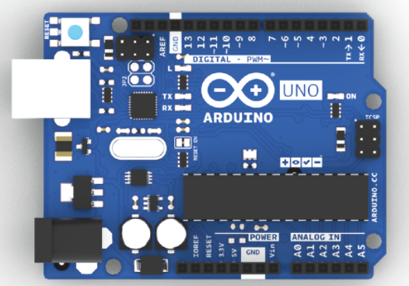




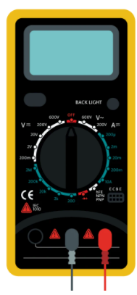

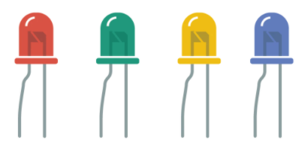
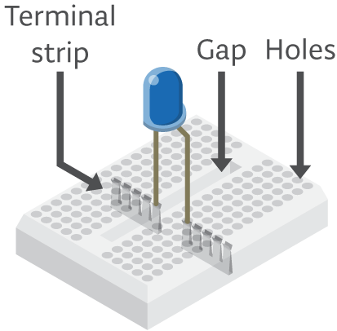
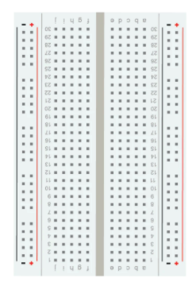
Review: Kit contents

Slide 6
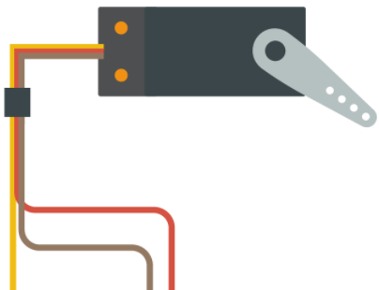




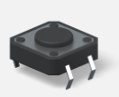
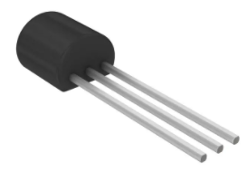
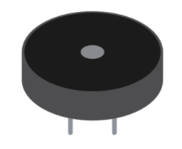
Review: Kit contents (cont’d)

Slide 7
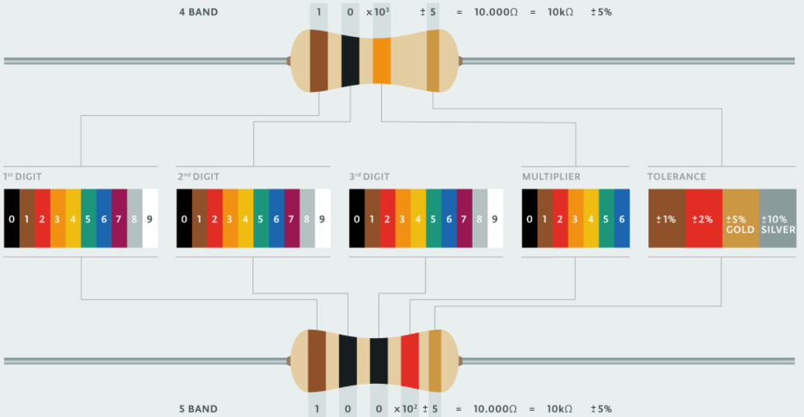
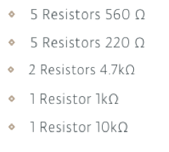
Review: Kit contents (resistors)

Slide 8
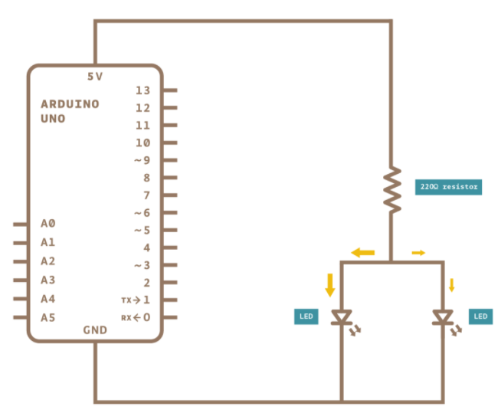
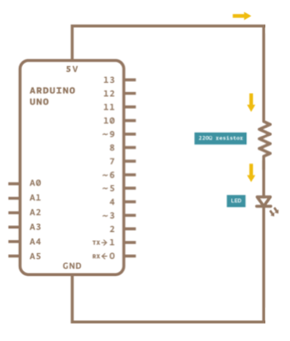
Circuit Review: Series vs Parallel
Parallel
Series
Electricity has one path and must go through both components one after another, i.e. in series!
Electricity has two parallel paths!

Slide 9
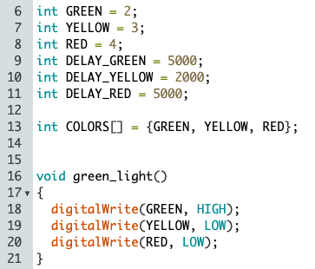
Code Review:
COLORS[] is an array
GREEN is a variable
The index of YELLOW in COLORS[] is two
green_light() is a function

Slide 10
Resources Review:
Student kit (all the circuit diagrams and code we used in the club): https://studentkit.arduino.cc/
Arduino tutorials: https://www.arduino.cc/en/Tutorial/HomePage?from=Main.Tutorials
MIT’s Scratch program is a great stepping stone that uses block coding, allowing you to learn the structure of programming before learning the actual languages themselves.
Code.org provides numerous resources connected to coding for those interested in learning the basics.
Code Academy is an interactive guide to learning multiple languages like JavaScript, HTML/CSS, and more.
Khan Academy has instructional courses on computer programming and computer science, it is an especially good resource for learning how to animate with code.
Also if you have any computer science classes offered at your school, I highly recommend taking them.
Typershark or any basic typing tutorial/software/class. Might seem boring, but proper typing skills will pay off in the future a thousand times over – you don’t want something so simple holding you back!
Maybe robotics and programming isn’t as interesting as you thought it would be, or maybe it’s just not enough! Explore these adjacent fields: Data Science, Robotics, Graphic Design, Engineering, Cybersecurity, Hacking, Machine Learning, Natural Language Processing, Network Design, Website creation.

Slide 11
Kahoot!

Slide 12
Lesson & Activity
Notes:
https://wcrsyyc.github.io/ardx/circ08.html

Slide 13
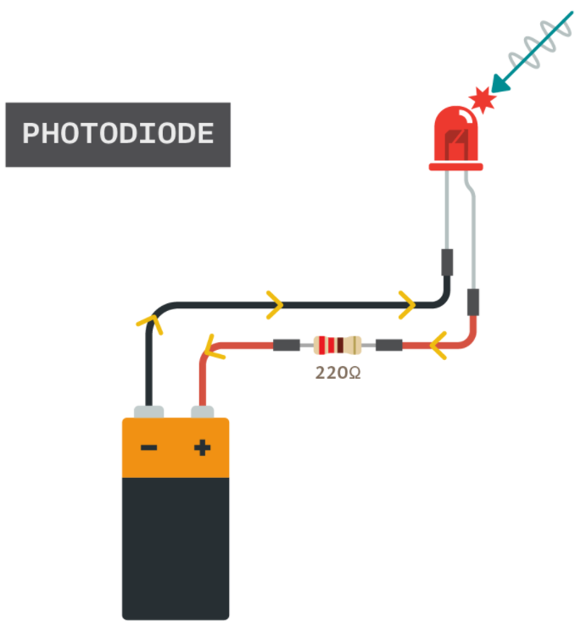
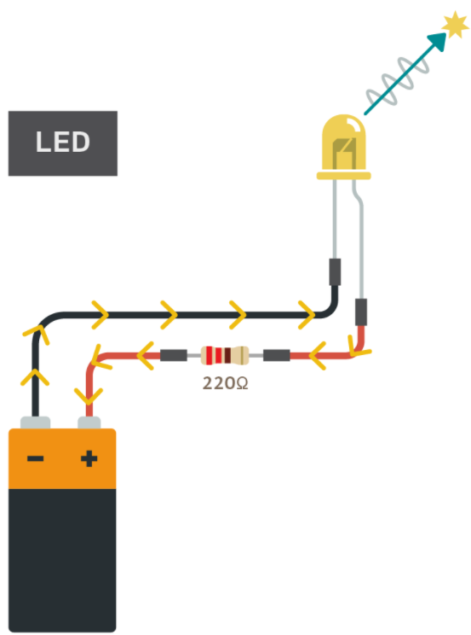
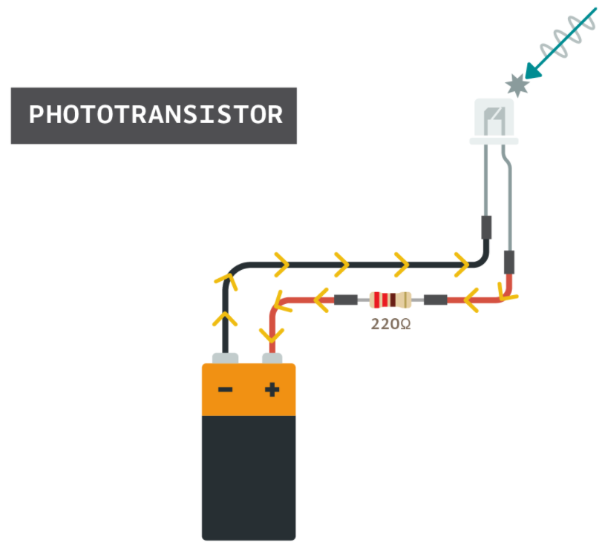
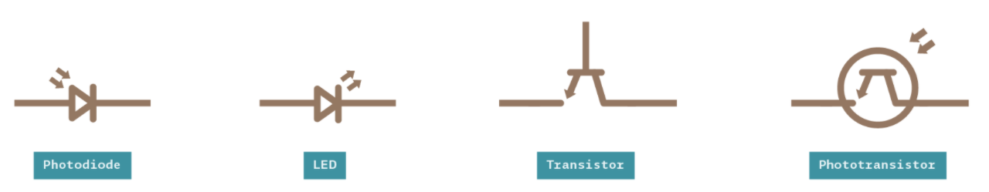
Photo transistor

Slide 14
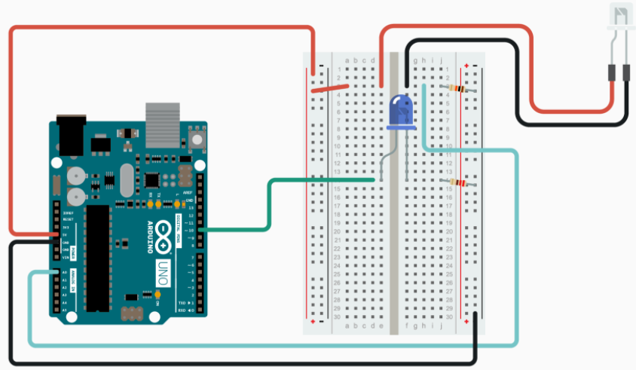
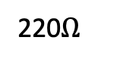
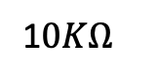
Light Sensor Activity
1$0KΩ$
220$Ω$
5V
Pin ~10
A0

Slide 15
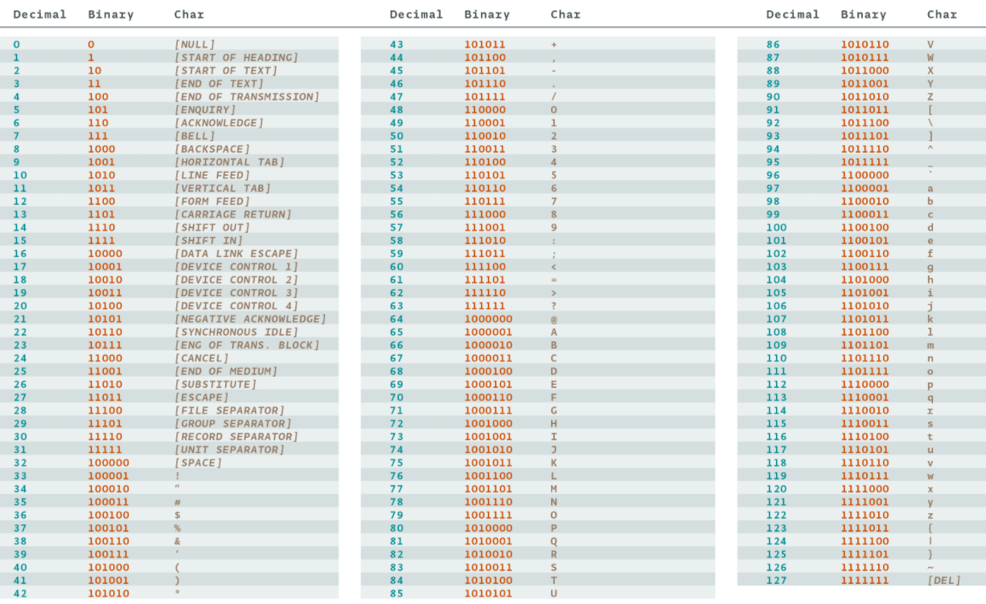
ASCII

Slide 16
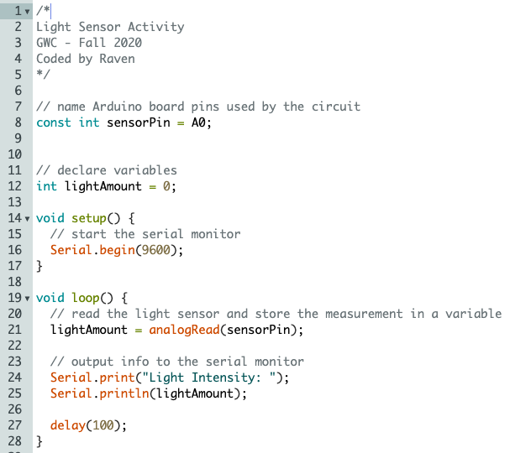
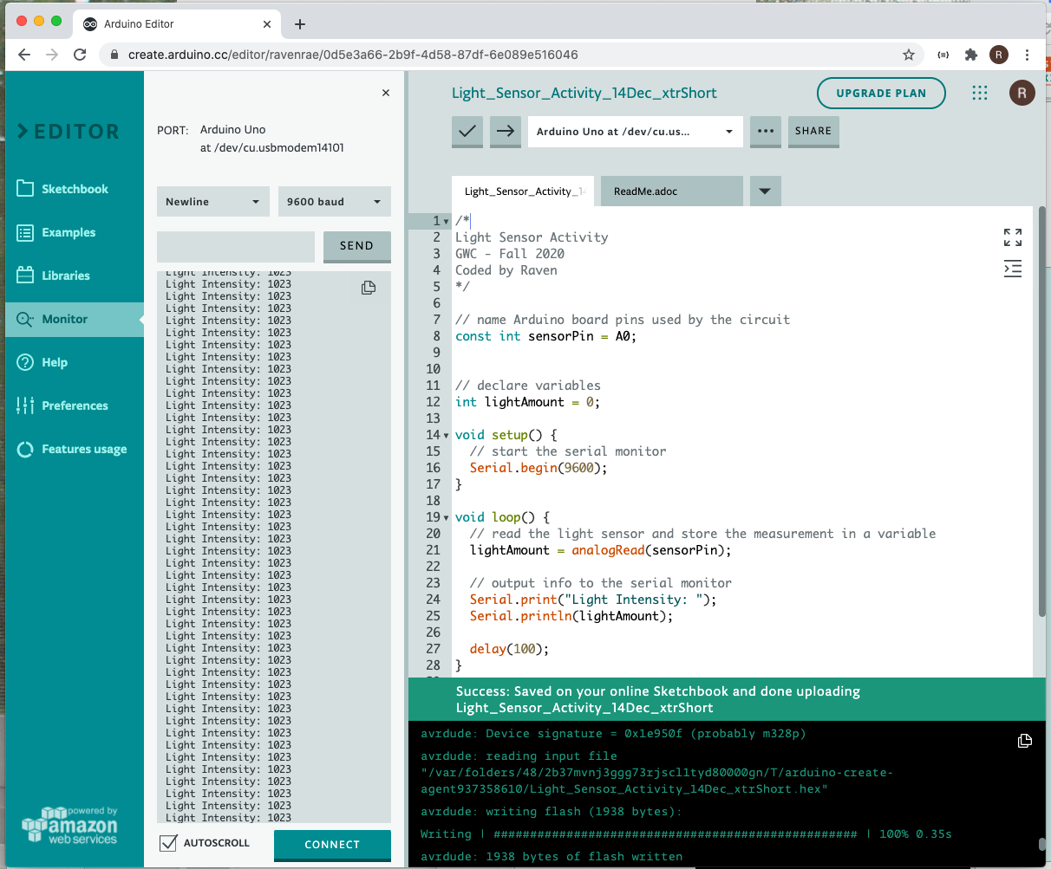
Light Sensor Activity
Arduino WebEditor: Use the Monitor Tab
Arduino IDE: 1) In the Arduino IDE, go to the Tools menu and then mouse over Port. Select the port associated with your Arduino board. 2) Click the Upload button to upload the sketch to your Arduino board. 3) Launch the serial monitor

Slide 17
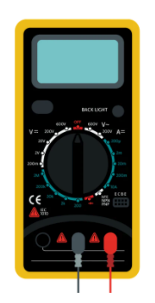
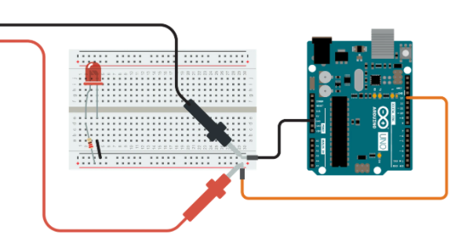
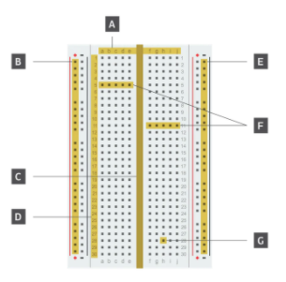

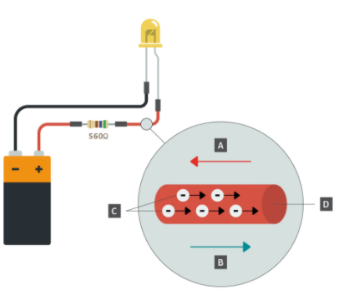
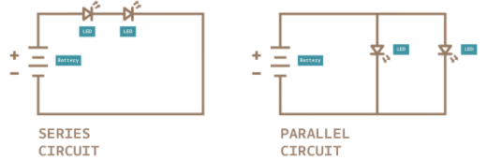
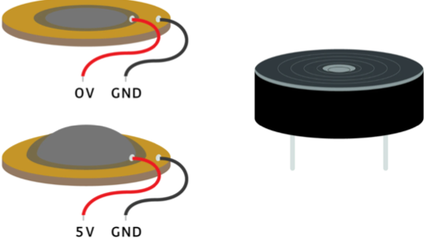
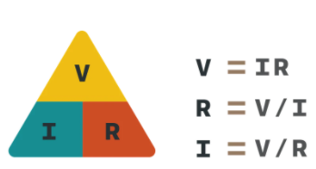
List of Accomplishments

Slide 18
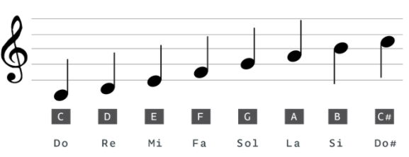
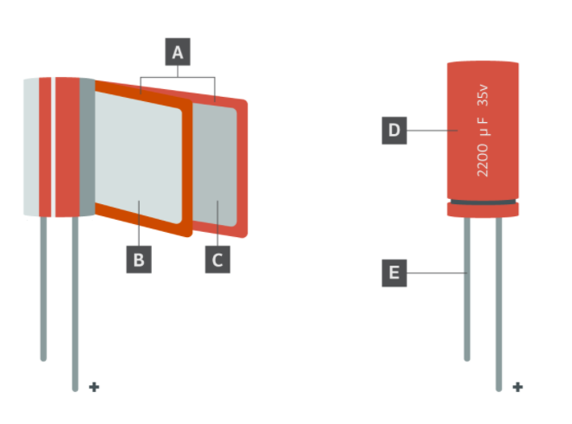
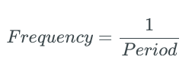
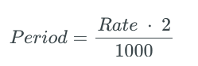
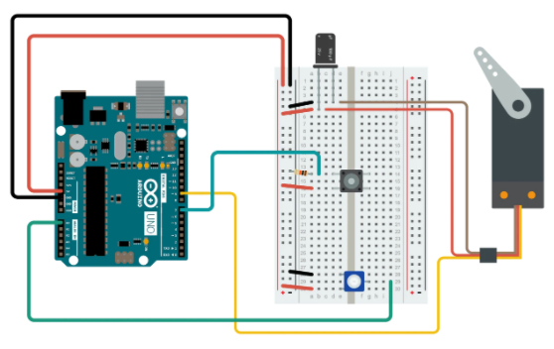
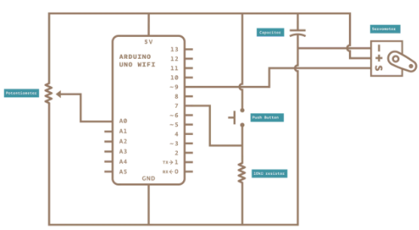
List of Accomplishments

Slide 19
Next Semester’s Club

Slide 20
Superlatives

Slide 21
Stand Ups
What did you learn from this club?
What STEM activity would you like to learn next?
Are there any impediments in your way?

Slide 22
Backup Material
Fei-Fei Li: How we are teaching computers to understand pictures. https://www.ted.com/talks/fei_fei_li_how_we_re_teaching_computers_to_understand_pictures?language=en

Slide 23
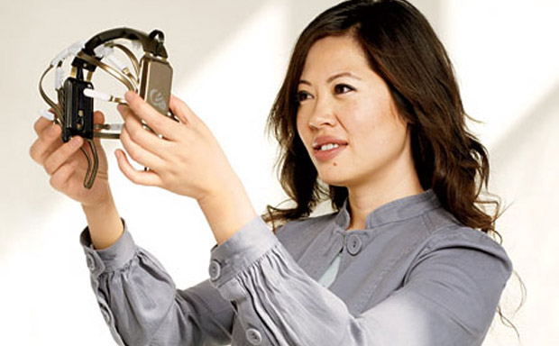
Women in Tech Spotlight: Tan Le
Accomplishments
Tan Le is the CEO and founder of Emotiv - a bioinformatics company.
The company is exploring a new “remote control” where a headset uses EEG technology to control digital devices by reading brain activity.
She is a refugee from Vietnam at age 4, she entered college at 16 and has since become a vital young leader in her home country of Australia. She attended Monash University in Melbourne, Australia where she studied law and commerce.
https://www.ted.com/talks/tan_le_a_headset_that_reads_your_brainwaves

Slide 24

Women in Tech Spotlight: Fei Fei Li
Accomplishments
Current director of Stanford Artificial Intelligence Lab, as well as the Stanford Vision Lab, Head of Google Cloud AI
B.S. in Physics from Princeton, with High Honors
PHD in Electrical Engineering from Cal Inst. Of Tech
2011 Sloan Fellowship recipient (43 fellows have gone on to win Nobel Peace Prizes)
Currently working to solve AI’s trickiest problems, including image recognition, learning, and language processing
Also works in cognitive neuroscience: studies how human brains work in order to apply those lessons to teaching machines to learn better
https://www.ted.com/talks/fei_fei_li_how_we_re_teaching_computers_to_understand_pictures

Slide 25
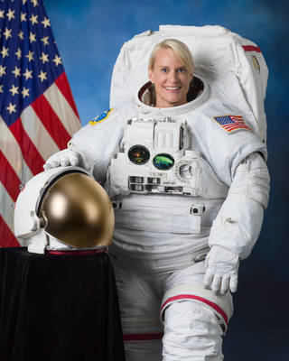
Women in Tech Spotlight: Kate Rubins
BS in Molecular Biology from University of California, San Diego
PhD in Cancer Biology from Stanford University Medical School
Fellow/Principal Investigator of a Lab at the Whitehead Institute for Biomedical Research of MIT studying viral diseases that primarily affect Central and West Africa and conducted research in the Democratic Republic of Congo
Selected to the Astronaut Corps in 2009
Expeditions 48 and 49 participating in more than 275 different scientific experiments
First person to sequence DNA in space, sequencing over 2 billion base pairs of DNA
Performed 2 space walks, including installing the new International Docking adapter, a new docking port for the US commercial crew spacecraft (i.e. the SpaceX flight that took place earlier this year)
Currently on board the International Space Station for Expedition 63/64
https://www.nasa.gov/astronauts/biographies/kathleen-rubins/biography

Slide 26
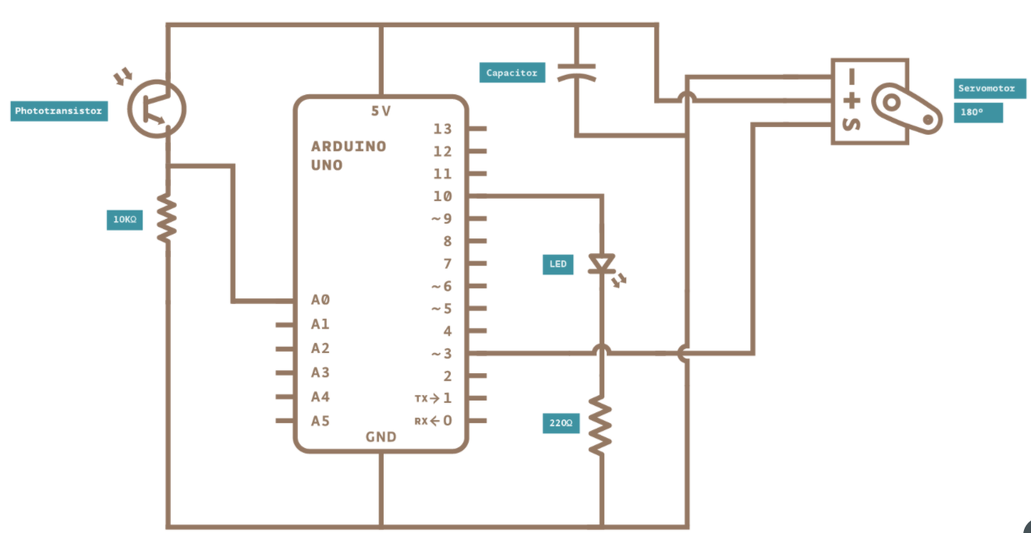
Light Wave RADAR

Slide 27
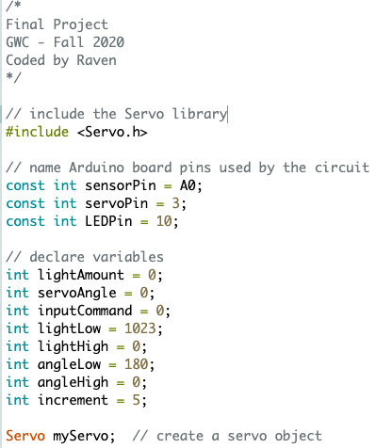
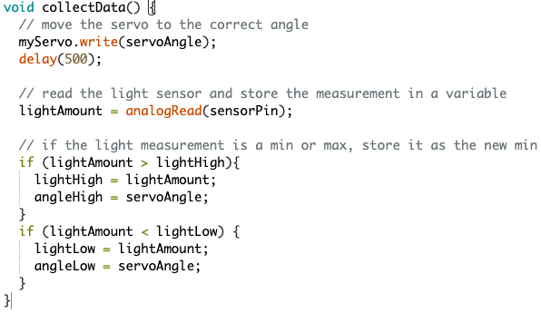
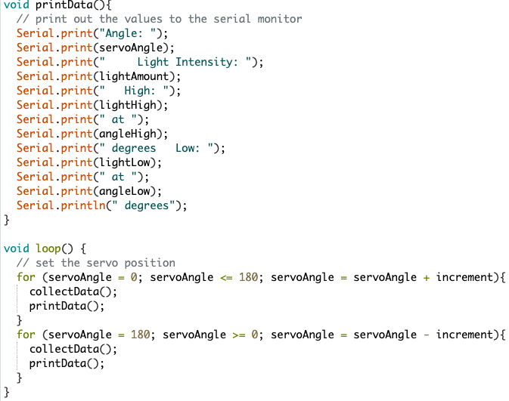
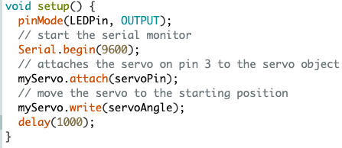
Light Wave RADAR

Slide 28
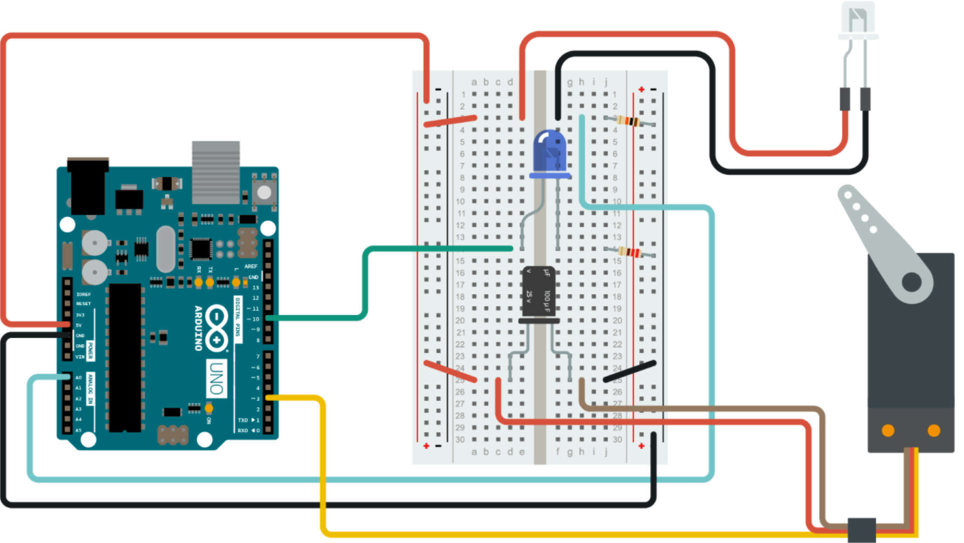
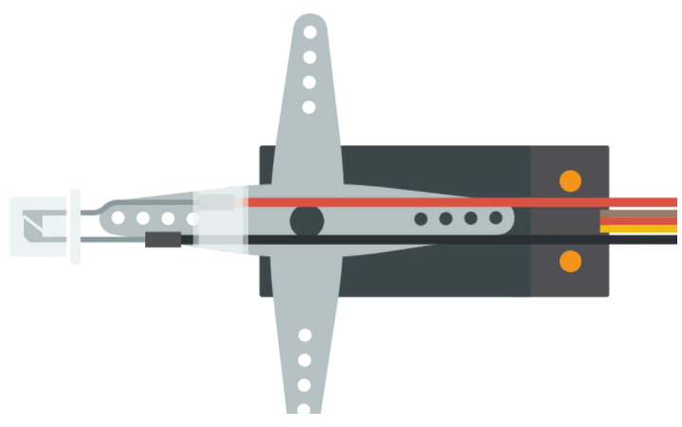
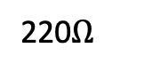
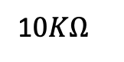
Light Wave RADAR
1$0KΩ$
220$Ω$
5V
Pin ~10
Servo Motor
A0
Pin ~3

Slide 29



Light Wave RADAR
LED
+
Servo Motor
=
Light Emitting Servo Motor Diode!!?

